Slide 1


CSCE 5610
Computer System Architecture
Virtual Memory

Slide 2
Processes
Deﬁnition: A process is an instance of a running program
One of the most important ideas in computer science
Not the same as “program” or “processor”

Slide 3
Concurrent Processes
Two processes run concurrently (are concurrent) if their instruction executions (ﬂows) overlap in time
Otherwise, they are sequential
Examples:
Concurrent: A & B, A & C
Sequential: B & C
Process A
Process B
Process C
time

Slide 4
User View of Concurrent Processes
Control ﬂows for concurrent processes are physically disjoint in time
However, we can think of concurrent processes as executing in parallel (only an illusion?)
Process A
Process B
Process C
time

Slide 5
Context Switching
Processes are managed by a shared chunk of OS code called the kernel
Important: the kernel is not a separate process, but rather runs as part of a user process
Control ﬂow passes from one process to another via a context switch… (how?)
Process A Process B
user code
kernel code
context switch
time
user code
kernel code
context switch
user code

Slide 6
Three problems of memory

Slide 7
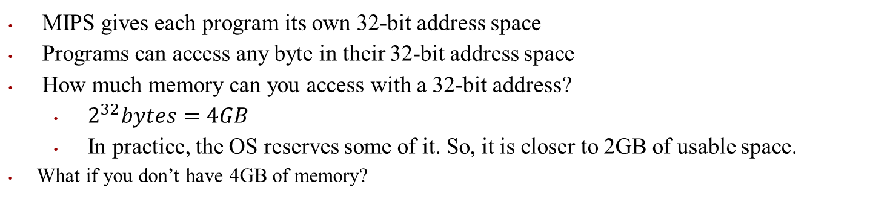



#1: What if we don’t have enough memory
MIPS gives each program its own 32-bit address space
Programs can access any byte in their 32-bit address space
How much memory can you access with a 32-bit address?
$2^{32}bytes=4GB$
In practice, the OS reserves some of it. So, it is closer to 2GB of usable space.
What if you don’t have 4GB of memory?
32-bit program address space (4GB)
30-bit RAM address space (1GB)
$$0X00000000$$
$$…to…$$
$$0XFFFFFFFF$$

Slide 8

#1: What if we don’t have enough memory
What if you don’t have 4GB of memory?
32-bit program address space (4GB)
30-bit RAM address space (1GB)
$$0X00000000$$
$$?$$
Crash if we try to access more than 1GB
$$…to…$$
$$0XFFFFFFFF$$

Slide 9
#2: Holes in our address space
How do programs share the memory?
Where do we put them?
Program 2
2GB
Program 3
2GB
Program 1
1GB
32-bit program address space (4GB)
$$0X00000000$$
$$…to…$$
$$0XFFFFFFFF$$

Slide 10
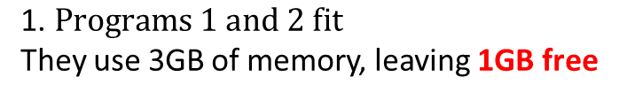
#2: Holes in our address space
How do programs share the memory?
Where do we put them?
Program 3
2GB
32-bit program address space (4GB)
$$\text{1. }Programs 1 and 2 fit$$
They use 3GB of memory, leaving 1GB free
$$0X00000000$$
Program 1
1GB
Program 2
2GB
$$…to…$$
$$0XFFFFFFFF$$

Slide 11
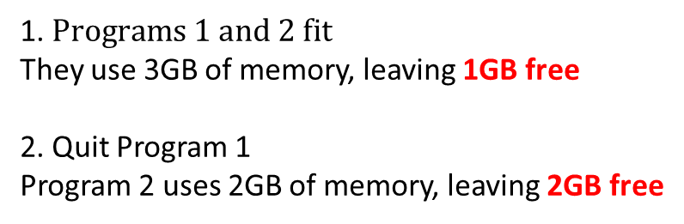
#2: Holes in our address space
How do programs share the memory?
Where do we put them?
Program 3
2GB
32-bit program address space (4GB)
1. $Programs 1 and 2 fit$
They use 3GB of memory, leaving 1GB free
2. Quit Program 1
Program 2 uses 2GB of memory, leaving 2GB free
$$0X00000000$$
Program 2
2GB
$$…to…$$
$$0XFFFFFFFF$$

Slide 12
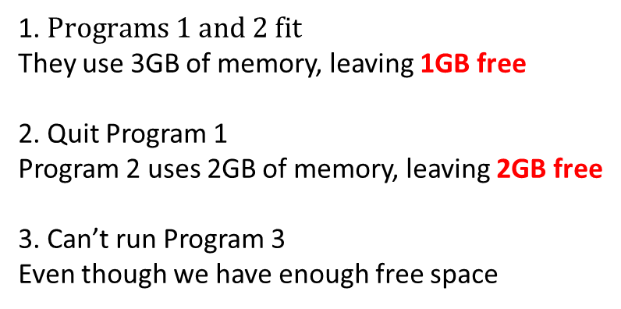
#2: Holes in our address space
How do programs share the memory?
Where do we put them?
Program 3
2GB
32-bit program address space (4GB)
1. $Programs 1 and 2 fit$
They use 3GB of memory, leaving 1GB free
2. Quit Program 1
Program 2 uses 2GB of memory, leaving 2GB free
3. Can’t run Program 3
Even though we have enough free space
$$0X00000000$$
Program 2
2GB
$$…to…$$
Memory fragmentation
$$0XFFFFFFFF$$

Slide 13
#3: How do we keep programs secure?
Each program can access any 32-bit memory address
What if multiple programs access the same address?
- sw $t0, 1024($0)
They can corrupt or crash each other: security and reliability
32-bit program address space (4GB)
Program 1
1GB
Program 2
2GB

Slide 14
Problems with memory
If all programs have access to the same 32-bit memory space:
Can crash if less than 4GB of RAM memory in the system
Can run out of space if we run multiple programs
Can corrupt other programs’ data
How do we solve this?

Slide 15
Problems with memory
If all programs have access to the same 32-bit memory space:
Can crash if less than 4GB of RAM memory in the system
Can run out of space if we run multiple programs
Can corrupt other programs’ data
How do we solve this?
Key to the problem: “Same memory space”

Slide 16
Problems with memory
If all programs have access to the same 32-bit memory space:
Can crash if less than 4GB of RAM memory in the system
Can run out of space if we run multiple programs
Can corrupt other programs’ data
How do we solve this?
Key to the problem: “Same memory space”
Can we give each program it’s own virtual memory space?
If so, we can:
Separately map each program’s memory space to the RAM memory space, and even move it to disk if we run out of memory

Slide 17
What is Virtual Memory?

Slide 18
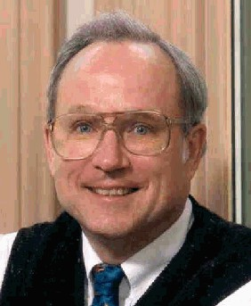
Indirection
“Any problem in CS can be solved by adding a level of indirection”
Without Indirection
Name
Thing
With Indirection
Name
Thing
Thing
Examples:
Pointers, Domain Name Service (DNS) name->IP address, phone system (e.g., cell phone number portability), snail mail (e.g., mail forwarding), 911 (routed to local office), DHCP, call centers that route calls to available operators, etc.

Slide 19
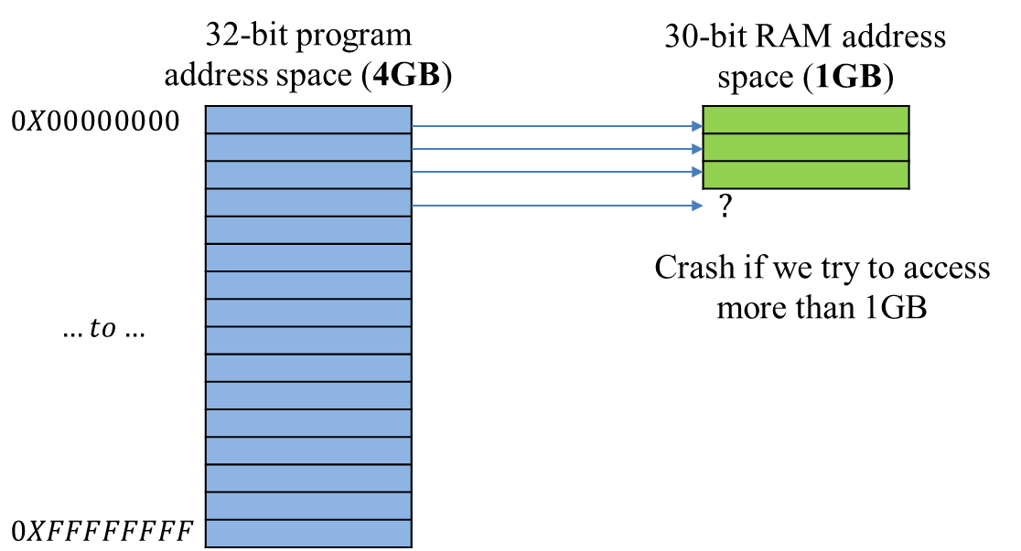
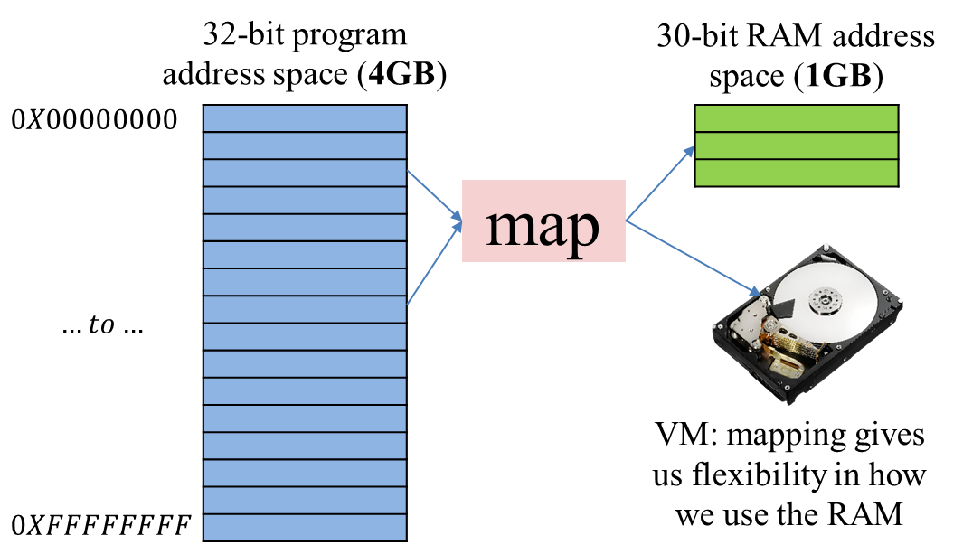
Virtual memory is a layer of indirection
“Any problem in Computer Science can be solved by adding indirection”
Virtual memory takes program addresses and maps them to RAM addresses
Without Virtual Memory
With Virtual Memory
Program Address = RAM Address
Program Address map to RAM Address

Slide 20
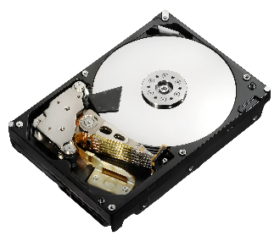
Solving the problems: #1 not enough memory
Map some of the program’s address space to the disk
When we need it, we bring it into memory
With Virtual Memory
Program Address map to RAM Address
32-bit program address space (4GB)
30-bit RAM address space (1GB)
$$0X00000000$$
map
$$…to…$$
$$0XFFFFFFFF$$

Slide 21
Solving the problems: #1 not enough memory
Map some of the program’s address space to the disk
When we need it, we bring it into memory
With Virtual Memory
Program Address map to RAM Address
32-bit program address space (4GB)
30-bit RAM address space (1GB)
map
Mapping lets us use our disk to give the illusion of unlimited memory

Slide 22

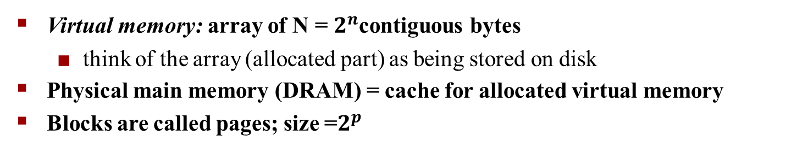
VM as a Tool for Caching
Virtual memory: array of N = $2^{n}$contiguous bytes
think of the array (allocated part) as being stored on disk
Physical main memory (DRAM) = cache for allocated virtual memory
Blocks are called pages; size =$2^{p}$
Disk
Virtual memory
Physical memory
VP 0
VP 1
Unallocated
Cached
Uncached
Unallocated
Cached
Uncached
Cached
Uncached
0
0
Empty
Empty
Empty
PP 0
PP 1
PP 2^{m-­‐p}-­‐1
VP 2^{n-­‐p}-­‐1
2^{m}-­‐1
2^{n}-­‐1
Virtual pages (VP's) stored on disk
Physical pages (PP's) cached in DRAM

Slide 23
Memory Hierarchy: Core 2 Duo
L1/L2 cache: 64 B blocks
Not drawn to scale
~4 MB
~4 GB
~500 GB
L1
I-­‐cache
L2
uniﬁed cache
Main Memory
Disk
32 KB
CPU
Reg
L1
D-­‐cache
Throughput: 16 B/cycle
Latency: 3 cycles
8 B/cycle
14 cycles
2 B/cycle
100 cycles
1 B/30 cycles millions
Miss penalty (latency): 30x
Miss penalty (latency): 10,000x

Slide 24
Solving the problems: #2 holes in address space
How do we use the holes left when programs quit?
We can map a program’s addresses to RAM addresses however we like
Program 3
2GB
32-bit program address space (4GB)
$$0X00000000$$
Program 2
2GB
$$…to…$$
$$0XFFFFFFFF$$

Slide 25
Solving the problems: #2 holes in address space
How do we use the holes left when programs quit?
We can map a program’s addresses to RAM addresses however we like
With Virtual Memory
Program Address map to RAM Address
32-bit program address space (4GB)
Program 2
2GB
$$0X00000000$$
map
Each program has its own mapping.
Mappings lets us put our program data wherever we want in the RAM.
$$…to…$$
Program 3
2GB
$$0XFFFFFFFF$$

Slide 26
Solving the problems: #3 keeping program secure
Program 1’s and Program 2’s addresses map to different RAM addresses
sw $t0, 1024($0)
With Virtual Memory
Program Address map to RAM Address
32-bit program address space (4GB)
Program 1
1GB
map
Program 2
2GB

Slide 27
Solving the problems: #3 keeping program secure
Because different processes will have different mappings from virtual to physical addresses, two programs can freely use the same virtual address.
By allocating distinct regions of physical memory to A and B, they are prevented from reading/writing each others data.
Program A
Physical Memory
Program B
Virtual Address
Virtual Address
Disk

Slide 28
Solution: Level Of Indirection
Virtual memory
mapping
Process 1
Physical memory
Virtual memory
Process n
Each process gets its own private memory space
Solves the previous problems

Slide 29
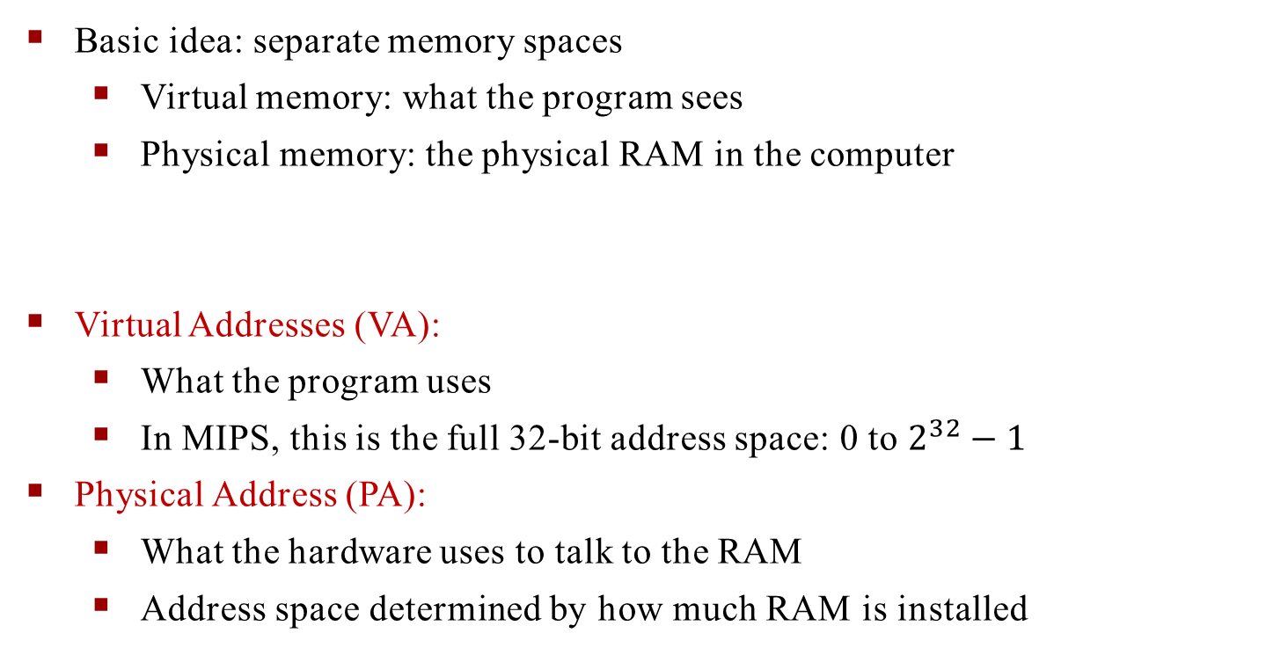
How does VM work?
Basic idea: separate memory spaces
Virtual memory: what the program sees
Physical memory: the physical RAM in the computer
Virtual Addresses (VA):
What the program uses
In MIPS, this is the full 32-bit address space: 0 to $2^{32}−1$
Physical Address (PA):
What the hardware uses to talk to the RAM
Address space determined by how much RAM is installed

Slide 30
A System Using Physical Addressing
Main memory
0:
1:
2:
3:
4:
5:
6:
7:
8:
Physical address
CPU
(PA)
...
M-­‐1:
Data word
Used in “simple” systems like embedded microcontrollers in devices like cars, elevators, and digital picture frames.

Slide 31
A System Using Virtual Addressing
Main memory
0:
1:
2:
3:
CPU Chip
Virtual address
Physical address
CPU
(VA)
MMU
(PA)
4:
5:
6:
7:
8:
M-­‐1:
Data word
...
Used in all modern desktops, laptops, workstations
One of the great ideas in computer science

Slide 32
A System Using Virtual Addressing
Main memory
0:
1:
2:
3:
CPU Chip
Virtual address
Physical address
CPU
(VA)
MMU
(PA)
4:
5:
6:
7:
8:
M-­‐1:
Data word
...
How would you do the VA -­‐> PA translation?

Slide 33
Page tables
The map from VA to PA is the page table
So far we have had one Page Table Entry (PTE) for every Virtual Address
How many entries do we need in our page table?
Virtual Address Space
Map
VA | PA
512 | 12
786 | Disk
1024 | 2

Slide 34
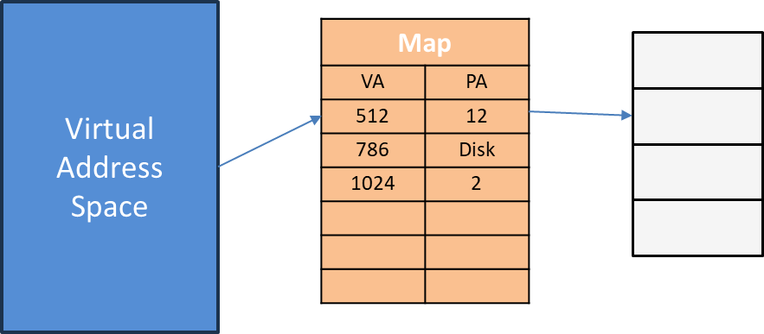
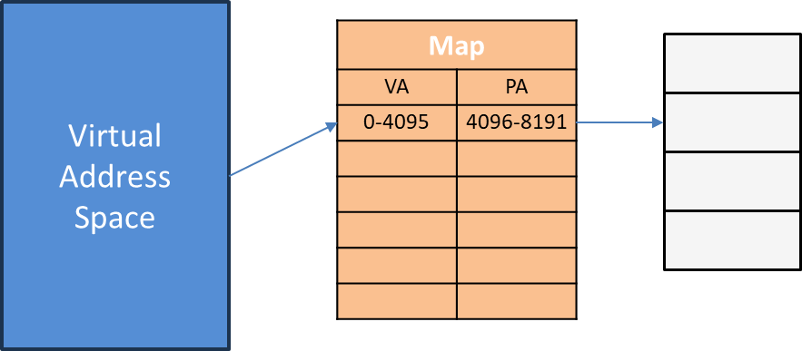
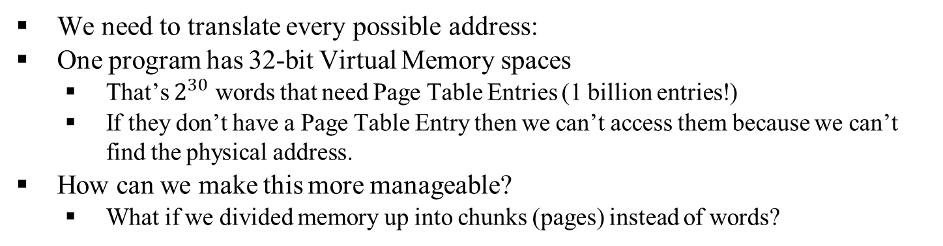

Page tables size
We need to translate every possible address:
One program has 32-bit Virtual Memory spaces
That’s $2^{30}$ words that need Page Table Entries (1 billion entries!)
If they don’t have a Page Table Entry then we can’t access them because we can’t find the physical address.
How can we make this more manageable?
What if we divided memory up into chunks (pages) instead of words?
Fine-grain: Maps each word address: $2^{30}$ words
Coarse-grain: Maps chunks of address: fewer mappings
pages

Slide 35
Coarse-grained: pages instead of words
The page table manages larger chunk (page) of data
Fewer Page Table Entries needed to cover the whole address space
But, less flexibility in how to use the RAM (have to move a page at a time)
Today:
Typically, 4kB pages (1024 words per page)
Question: How many entries do we need in our Page Table with 4kB pages on a 32-bit machine?
Sometimes 2MB pages
Question: How many entries do we need in our Page Table with 4kB pages on a 32-bit machine?

Slide 36








How do we map address with pages?
Virtual Address Space
Physical Address Space
Coarse-grain: Maps chunks of address: fewer mappings
4KB
4KB
4KB
4KB
4KB
4KB
4KB
$$8191$$
$$8191$$
Question: What is the Physical Address for Virtual Address 4?
$$4096$$
$$4096$$
$$4095$$
$$4095$$
$$0$$
$$0$$

Slide 37
Address translation
What happens on a 32-bit machine with 256MB RAM and 4kB pages?
32-bit Virtual Address
28-bit Physical Address
32-bit
Page table
28-bit

Slide 38


Address translation
What happens on a 32-bit machine with 256MB RAM and 4kB pages?
32-bit Virtual Address
28-bit Physical Address
Page offset
32-bit
$$12−bit$$
Page table
28-bit
$$12−bit$$
Each PTE contains 4kB of address space…
For every page we have 4096 addresses (12 bits) that don’t get translated

Slide 39
Address translation
What happens on a 32-bit machine with 256MB RAM and 4kB pages?
32-bit Virtual Address
28-bit Physical Address
Virtual page number
Page offset
20-bit
$$12−bit$$
Page table
16-bit
$$12−bit$$
Physical page number
But each PTE contains 4kB of address space…
For every page we have 4096 addresses (12 bits) that don’t get translated

Slide 40








Pages, offsets, and translation
What happens on a 32-bit machine with 256MB RAM and 4kB pages?
32-bit Virtual Address
28-bit Physical Address
Virtual Address Space
Physical Address Space
Virtual page number
Page offset
Physical page number
Page offset
4KB
4KB
4KB
4KB
Virtual page number 3
4KB
4KB
4KB
Virtual page number 2
Physical page number 2
$$8191$$
$$8191$$
Virtual page number 1
Physical page number 1
$$4096$$
$$4096$$
$$4095$$
$$4095$$
Virtual page number 0
Physical page number 0
$$0$$
$$0$$

Slide 41
How to do a page table lookup?
What happens on a 32-bit machine with 256MB RAM and 4kB pages?
32-bit Virtual Address
28-bit Physical Address
Virtual Address (VA) size set by ISA
32-bit
Page table
28-bit
Physical Address (VA) size set by the amount of RAM

Slide 42
How to do a page table lookup?
What happens on a 32-bit machine with 256MB RAM and 4kB pages?
32-bit Virtual Address
28-bit Physical Address
Virtual Address (VA) size set by ISA
20-bit
$$12−bit$$
4kB=12bits for page offset
Page table
16-bit
$$12−bit$$
Physical Address (VA) size set by the amount of RAM

Slide 43


How to do a page table lookup?
What happens on a 32-bit machine with 256MB RAM and 4kB pages?
32-bit Virtual Address
28-bit Physical Address
20-bit
$$12−bit$$
Page table
0X00000 | DISK
0X00001 | 0X0003
0X00002 | 0X0004
… | …
0XFFFFF | 0X00F6
16-bit
$$12−bit$$

Slide 44


Example Translation
What happens on a 32-bit machine with 256MB RAM and 4kB pages?
32-bit Virtual Address
28-bit Physical Address
0X00002
$$0X204$$
Page table
0X00000 | DISK
0X00001 | 0X0003
0X00002 | 0X0004
… | …
0XFFFFF | 0X00F6
0x0004
$$0X204$$

Slide 45

Question
What happens on a 32-bit machine with 256MB RAM and 4kB pages?
32-bit Virtual Address
28-bit Physical Address
0X00001
$$0X783$$
Page table
0X00000 | DISK
0X00001 | 0X0003
0X00002 | 0X0004
… | …
0XFFFFF | 0X00F6
?

Slide 46
Question
If we have 64kB pages, how many bits do we use for the page offset?
Page table

Slide 47
Address Translation: Page Tables
A page table is an array of page table entries (PTEs) that maps virtual pages to physical pages. Here: 8 VPs
Physical memory (DRAM)
Physical page number or disk address
Valid
VP 1
VP 2
VP 7
VP 4
PP 0
PTE 0
0
null
1
PP 3
1
0
1
0
null
Virtual memory (disk)
0
PTE 7
1
VP 1
Memory resident page table (DRAM)
VP 2
VP 3
VP 4
How many page tables in the system?
VP 6
VP 7

Slide 48
Address Translation With a Page Table
Virtual address
Page table base register (PTBR)
Virtual page number (VPN)
Virtual page offset (VPO)
Page table
Valid Physical page number (PPN)
Page table address for process
Valid bit = 0: page not in memory
(page fault)
Physical page number (PPN)
Physical page offset (PPO)
Physical address

Slide 49



Caching Translations
Virtual to Physical translations are cached in a Translation Lookaside Buffer (TLB).
31 30 29 15 14 13 12 11 10 9 8 3 2 1 0
Virtual page number
Page offset
20
12
Valid Dirty
Tag
Physical page number
TLB
TLB hit
20
Physical page number
Physical address
Page offset
Physical address tag Cache index
Byte offset
16 14
2
Valid
Tag
Data
Cache
32
Cache hit
Data
Notes:
Virtual address to physical address
Physical to page offset.

Slide 50
Page Hit
Page hit: reference to VM word that is in physical memory
Physical memory (DRAM)
Virtual address
Physical page
number or
Valid
disk address
VP 1
VP 2
VP 7
VP 4
PP 0
PTE 0
0
null
1
PP 3
1
0
1
0
null
Virtual memory (disk)
0
PTE 7
1
VP 1
Memory resident page table (DRAM)
VP 2
VP 3
VP 4
VP 6
VP 7

Slide 51
Page Miss
Page miss: reference to VM word that is not in physical memory (shOOt!)
Physical memory (DRAM)
Physical page
Virtual address
number or
Valid
disk address
VP 1
VP 2
VP 7
VP 4
PP 0
PTE 0
0
null
1
PP 3
1
0
1
0
null
Virtual memory (disk)
0
PTE 7
1
VP 1
Memory resident page table (DRAM)
VP 2
VP 3
VP 4
VP 6
VP 7

